Slide 1

Project
Your Boss: “Build a 12-month equity portfolio forecasting and risk assessment model.
Quantify downside exposure under multiple macro scenarios and recommend allocation adjustments to reduce portfolio risk.” You are acting as:
Junior Risk Analyst
Finance & Strategy Analyst
Fintech Data Analyst

Slide 2
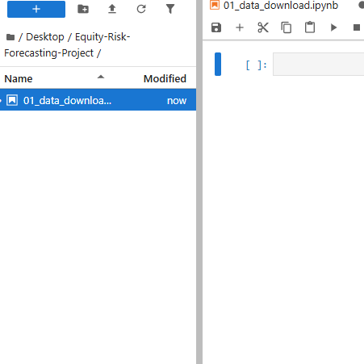
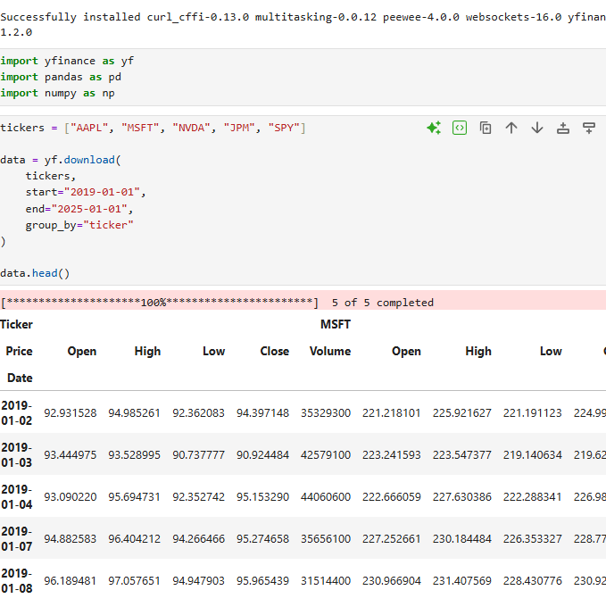
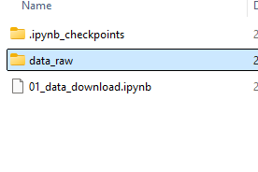
Day 1 Objective
By the end of today I will:
-Select portfolio assets
-Download clean historical data
-Organize project folders
-Set up SQL environment
-Understand what metrics you will calculate
-Define your risk framework structure
New Notebook in Python
Pull Market Data
Pick 5 stocks:
AAPL, MSFT, NVDA, JPM, SPY (market benchmark)
Why?
Large-cap, High liquidity, Bellwether Next: I used Python to automate the ingestion of historical stock data rather than relying on manual downloads.
Raw Data Sub Folder created

Slide 3
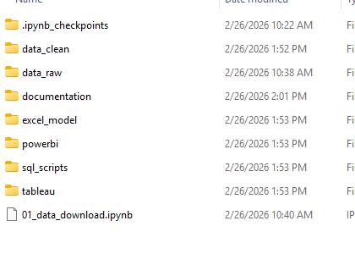
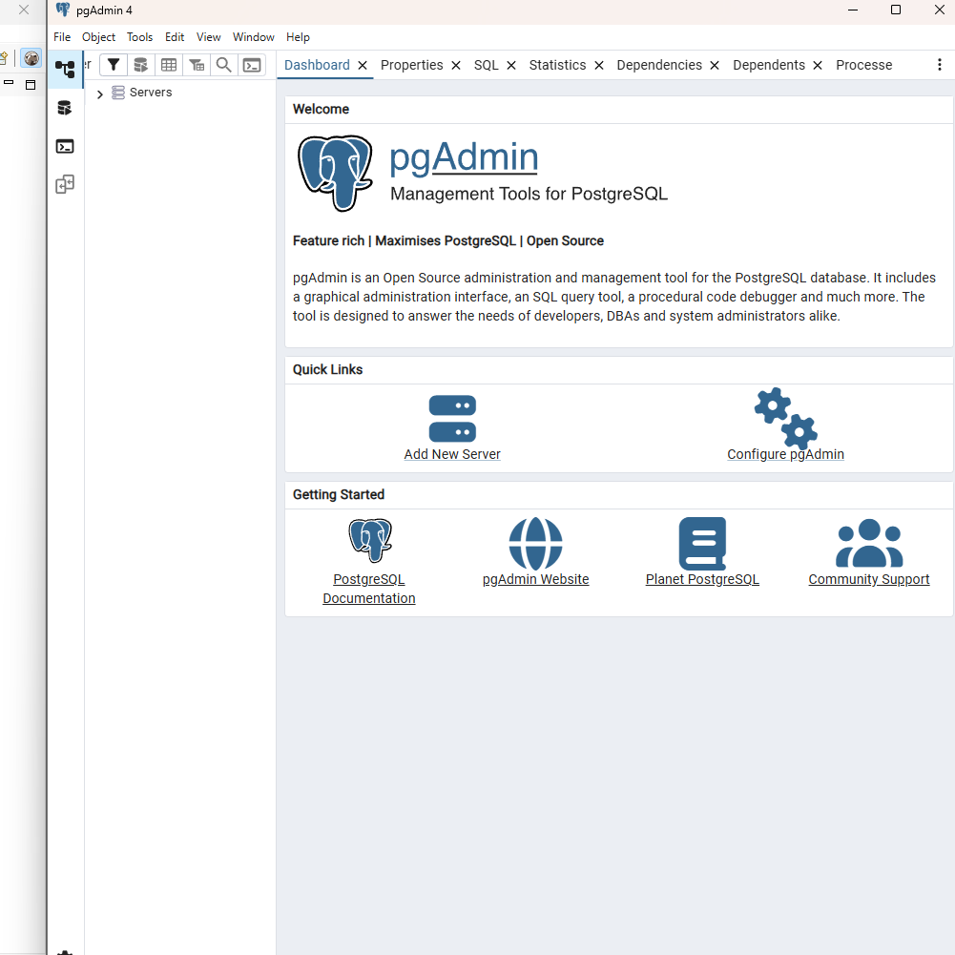
What I Learned Today (Transferable Skills)
Project structuring
Data sourcing
Portfolio construction
Risk framework planning
Professional workflow design
What I Just Did
Used an API-based data pull
Created a structured dataset
Built a reproducible pipeline
Avoided manual CSV downloads
Project Folder Structure
PostgreSQL and DBeaver ready for Day 2!

Slide 4
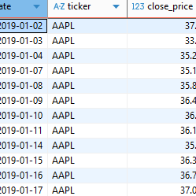
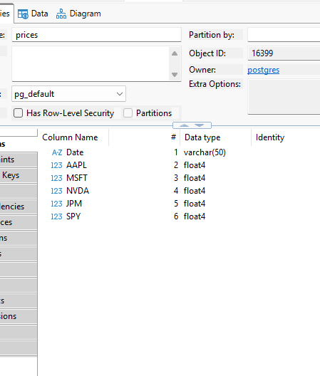
Step 3 - Calculate Daily Returns: “I used SQL window functions, specifically LAG, to compute daily returns by partitioning data by ticker and ordering by date.” LAG is an SQL function - LAG allows you to reference the previous row’s value in a time series.
What is a window function? - Perform calculations across rows that are related to the current row — without collapsing the dataset.
Day 2 Objective
By the end of today I will:
-Create a database
-Import price data into SQL
-Build a structured price table
-Calculate daily returns
-Prepare dataset for volatility modeling
Price Data Imported
Calculate Daily returns with LAG window function
Transferable Skill:
I calculated rolling 30-day volatility using SQL window functions and standard deviation to measure short-term risk exposure.

Slide 5
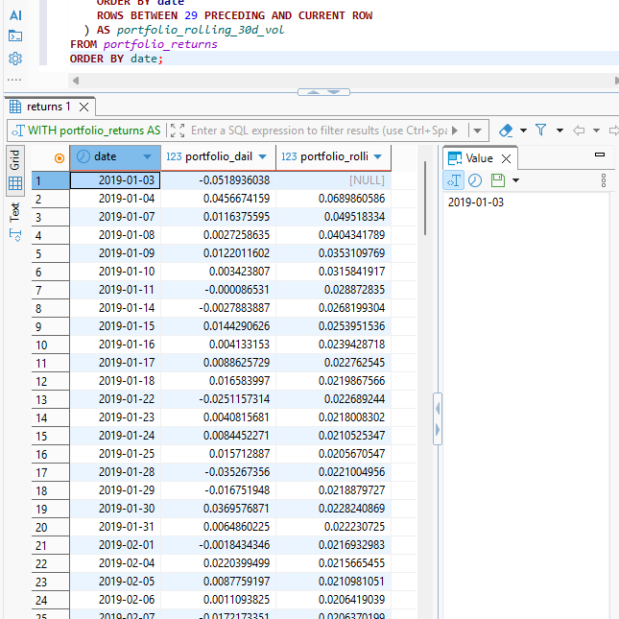
What I did (End of Day 2)
“I created a portfolio return series in SQL by joining a weights table to daily returns and calculating weighted daily performance.”
Skills Shown: 1. SQL Window Functions
2. Time-Series Financial Analysis
3. Portfolio Modeling
4. Risk Measurement & Volatility Analysis
5. Relational Database Structuring
6. Data Pipeline Development
7. Quantitative Problem Solving
*Applied mathematical return formulas and statistical measures to real market data.

Slide 6
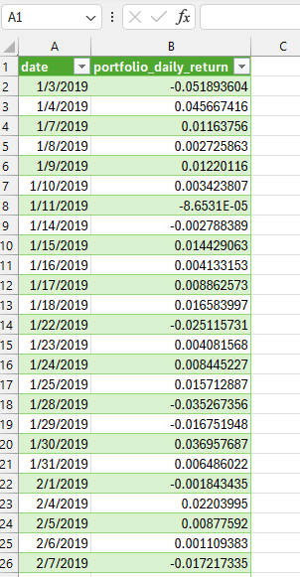
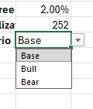
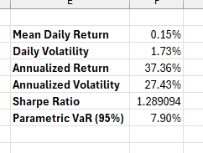
Checklist: Prepare model inputs to support Day 4 Monte Carlo VaR/CVaR simulation What I am doing: Built an Excel-based risk framework using SQL-derived daily returns to calculate annualized return (37%), volatility (27%), Sharpe ratio (1.3), and parametric VaR to evaluate portfolio risk-adjusted performance
I built a scenario switch that instantly re-forecasts risk/return metrics from a single control.
Day 3 Objective
By the end of today I will:
-Build a structured Excel risk framework
-Calculate annualized return and volatility
-Compute Sharpe Ratio and Parametric VaR (95%)
-Implement Base / Bull / Bear scenario modeling
-Create a 2-way sensitivity table
-Build a clean executive risk summary section
Created Dropdown Menu
Portfolio Data Imported
Risk Framework
Real Financial Modeling:
Mean daily return
Daily volatility
Annualized return
Annualized volatility

Slide 7
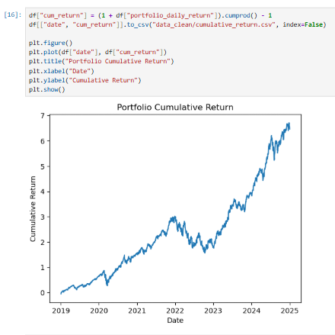
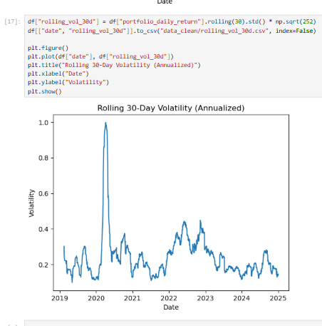

What I learned:
I produced dashboard-ready risk KPI and time-series outputs from Python that can plug directly into Power BI.
Game Plan:
Export portfolio daily returns
Load into Python (pandas)
Compute:
Mean, Vol, Sharpe
Build:
2-way sensitivity matrix
Monte Carlo distribution
Export:
Heatmap image, VaR results
Embed image back into Power BI

Slide 8
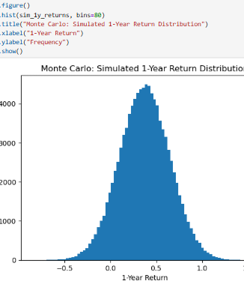
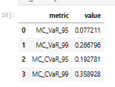
Day 4 Monte Carlo VaR/CVaR simulation
I built a full annualized risk framework, then extended it using Monte Carlo simulation to model 1-year probabilistic tail risk and compare parametric vs simulated VaR.
I compute:
VaR 95%
VaR 99%
CVaR 95% (Expected Shortfall)
CVaR 99%
Day 4 Objective
By the end of today I will:
-Implement a Monte Carlo simulation engine in Python
-Generate simulated return paths using portfolio mean and volatility
-Compute Value at Risk (95% and 99%) from the simulated distribution
-Compute Conditional VaR (Expected Shortfall)
-Compare Parametric VaR vs Monte Carlo VaR
-Visualize the full return distribution and downside tail risk
-Export simulation outputs for Power BI dashboard integration
Reality Check:
You should see numbers larger than VaR.
CVaR > VaR always.
VaR = threshold loss
CVaR = average loss beyond threshold
CVaR is institution-level risk measurement.
Histogram in Python

Slide 9
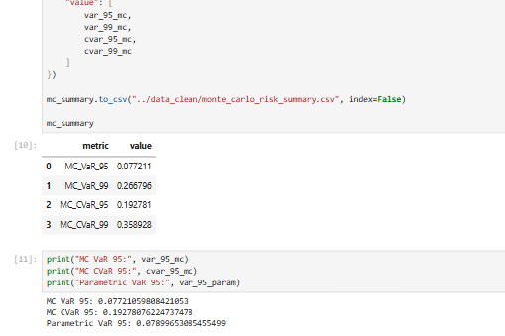
What Does this All Mean!!!!:
MC VaR 95 ≈ 7.72%
MC CVaR 95 ≈ 19.28%
Parametric VaR 95 ≈ 7.89%
Interpretation:
Monte Carlo VaR and Parametric VaR are very close
→ My distribution assumption is behaving consistently.
CVaR is much larger (~19%)
→ Once I breach the 95% threshold, the average loss in the tail is materially worse.
***That’s a strong risk insight.
What i have:
KPI summary
Sensitivity matrix
Monte Carlo VaR
Monte Carlo CVaR
Full simulated distribution dataset
Clean export pipeline to BI

Slide 10
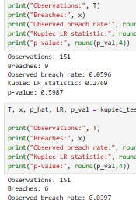
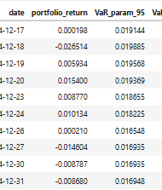
Day 5 Backtesting & VaR Validation
Today, We are answering the question: Does your VaR model actually work historically?
This is a real risk management question that needs to be answered!
Deliverables: at the end of Day 5: a notebook that generates (1) plots, (2) a backtest summary table, and (3) exported CSVs for your portfolio backtesting results.
Day 5 Objective
By the end of today I will:
-Build a VaR backtesting pipeline
-Computes VaR exceptions (breaches) for each confidence level (e.g., 95%, 99%)
-Produces backtesting diagnostics (exception rate, clustering, stability over time)
-Runs standard validation tests (Kupiec POF; optional Christoffersen independence)
-Outputs a Basel-style “traffic light” summary and a clean results table
Regulatory VaR validation test
Rolling Parametric VaR forecasts

Slide 11
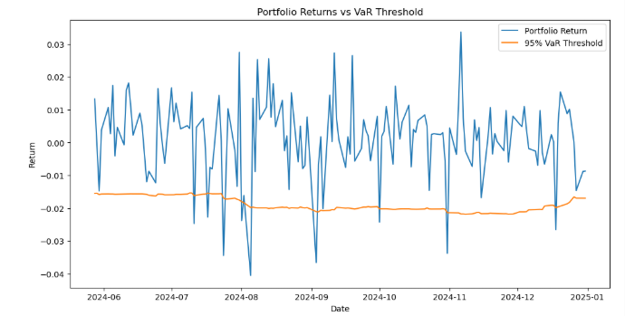
What i Did: defining backtest rules (VaR sign convention + breach definition) in the notebook.
Why? Risk teams define conventions before calculations.
I just established:
• Confidence levels: 95% and 99%
• Backtest window: 250 trading days
• Loss convention: VaR expressed as positive loss
• Exception rule: return < −VaR
This prevents look-ahead bias and inconsistent breach detection.
What I did: pull the realized portfolio returns from your SQL database
What i Did: I implemented a regulatory VaR validation test used in:
Basel risk frameworks
bank trading desks
hedge fund risk monitoring
fintech risk analytics
Visualize returns vs VaR

Slide 12

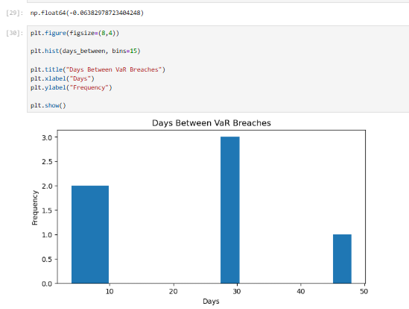
I validated 1-day 95%/99% VaR forecasts by backtesting against realized portfolio returns, quantifying exceptions, running Kupiec coverage tests, and summarizing model health using a Basel-style traffic light framework.
Deliverable Below ready for Export ***
Reality check: Do we have a healthy model? | Value | Meaning
| ~0 | good
| >0.3 | clustering |
| <0 | random Our Number: -.06
Healthy models show a wide spread of spacing. Graph on right checks out!

Slide 13

Day 5 Intermission: Over the past five days, I built a portfolio risk monitoring workflow that helps evaluate how much loss a portfolio could experience during volatile market conditions. I first organized historical price data in a structured database and calculated daily portfolio returns. Using this data, I developed risk metrics such as volatility, Sharpe ratio, and Value-at-Risk (VaR), and simulated thousands of potential market scenarios with Monte Carlo analysis to estimate potential losses. I then validated the model by comparing predicted risk levels to actual outcomes, measuring when losses exceeded forecasts. The result is a transparent risk framework that helps managers understand portfolio risk and assess whether the model reliably captures market uncertainty.

Slide 14
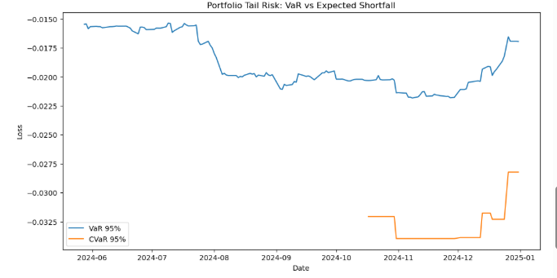
Day 6 Objective
By the end of today I will:
-Extend my risk framework beyond VaR by calculating Expected Shortfall (CVaR)—the average loss when VaR is breached.
Why?: This improves risk measurement because VaR tells you the threshold, while CVaR tells you how severe losses are when things go wrong.
Compare CVaR and VaR
Transferable Skills Shown: Tail risk measurement using Expected Shortfall
Financial risk model comparison (VaR vs CVaR)
Scenario-driven loss analysis
Risk communication for non-technical stakeholders
Quantitative portfolio diagnostics
Deliverables today:
Daily CVaR estimates
Tail loss analysis
VaR vs CVaR comparison chart
Exported results for the project
Communication to Stakeholders: I exxtended the portfolio risk framework to include Expected Shortfall, enabling deeper analysis of extreme losses beyond VaR thresholds and improving the model’s ability to capture tail risk during volatile market conditions.

Slide 15
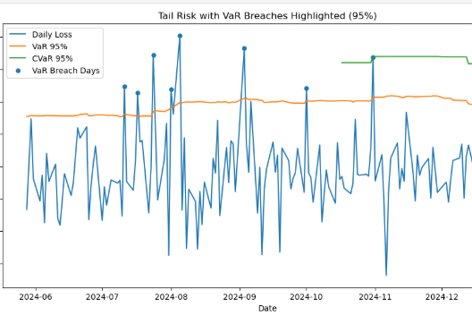
More Presentation Friendly Updates:
Upgrade 1: Plot losses as positive numbers (easier for non-technical viewers)
Upgrade 2: Highlight breach days on the chart
Upgrade 3: Format y-axis as %
What you should see: (Reality Check)
*Loss spikes upward
*CVaR line above VaR line (because CVaR is worse tail loss)

Slide 16
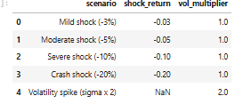
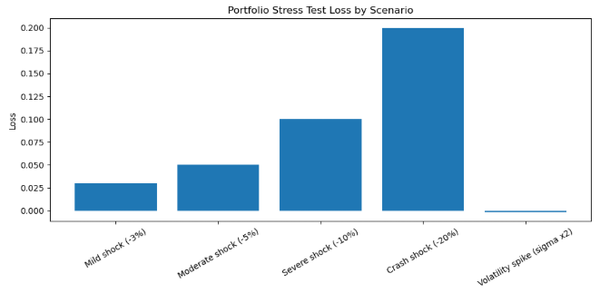
Day 7 — Stress Testing & Scenario Analysis
By the end of today I will:
Create a stress testing module that answers: “What happens to my portfolio under extreme market moves?” using:
Historical stress window from data (COVID crash period in 2020, since data starts ~2019)
Hypothetical shocks (e.g., −5%, −10%, −20% one-day move; volatility doubling)
Clear outputs for stakeholders: loss estimates, VaR/CVaR under stress, and scenario summary table
Define Stress Scenarios
Visualize Scenario Losses

Slide 17
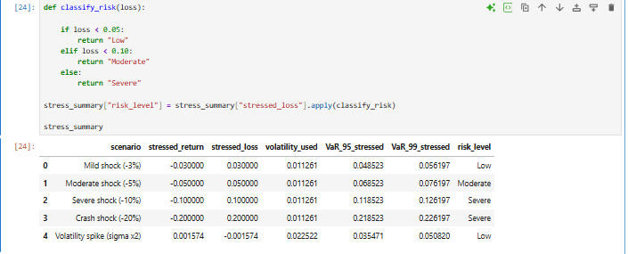
Lets Answer the Question
If volatility jumps (or markets crash), how much worse does our VaR get?
What Day 7 added to my project
You now have a full stress testing module:
Market shock scenarios
Volatility spike analysis
Stressed VaR
Scenario loss estimates
Visual charts
Manager-ready summary table
Readable Table for Stakeholders

Slide 18
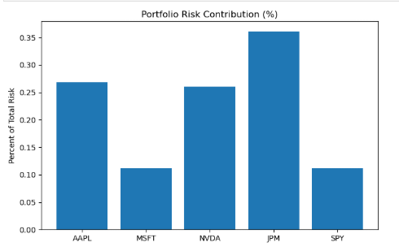
Day 8 Objective
By the end of today I will:
-Break down total portfolio volatility to show which stocks contribute most to portfolio risk.
Compare CVaR and VaR
I am showing “risk contribution analysis”: Let’s Answer the Question: What positions are driving our portfolio risk?
Risk Contribution per Asset
What Day 8 adds to my Project: Which stocks drive portfolio volatility
Which assets are risk concentration points
How diversification actually affects risk

Slide 19
I validated 1-day 95%/99% VaR forecasts by backtesting against realized portfolio returns, quantifying exceptions, running Kupiec coverage tests, and summarizing model health using a Basel-style traffic light framework.
Deliverable Below ready for Export ***
Reality check: Do we have a healthy model? | Value | Meaning
| ~0 | good
| >0.3 | clustering |
| <0 | random Our Number: -.06
Healthy models show a wide spread of spacing. Graph on right checks out!

Slide 20
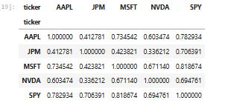
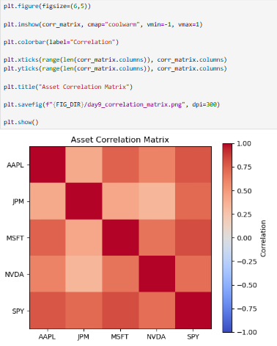
Day 9 Objective Topic: Diversification analysis
By the end of today I will:
Measure how diversified my portfolio actually is using:
Diversification Ratio
Average correlation between assets
Comparison: diversified portfolio vs equal-weighted risk
Correlation Matrix
Correlation Structure Visualized
Today we will answer the question:
Is this portfolio truly diversified, or are assets moving together? What I did: I quantified the diversification benefits of the portfolio by comparing weighted asset volatility to total portfolio volatility, calculating the diversification ratio, and analyzing the correlation structure across assets.

Slide 21
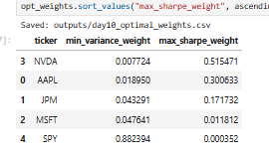
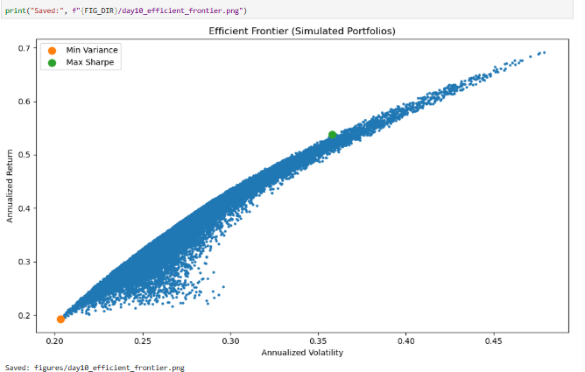
Day 10 Objective
Portfolio Optimization (Efficient Frontier + Optimal Weights)
Use historical returns to build:
an efficient frontier (risk vs return curve)
the minimum-variance portfolio
the max Sharpe (tangency) portfolio
Found Minimum Variance and Maximum Sharpe
Explain term “Efficient Frontier” to Non-Technical Stakeholders: The efficient frontier shows the best possible investment portfolios you can build for different levels of risk.
Imagine you’re choosing between many possible portfolios. Some give low return with high risk, which is obviously bad. Others give higher return for the same risk, which is better.
Minimum variance portfolio → lowest risk possible
Maximum Sharpe portfolio → best risk-adjusted return
Efficient Frontier

Slide 22
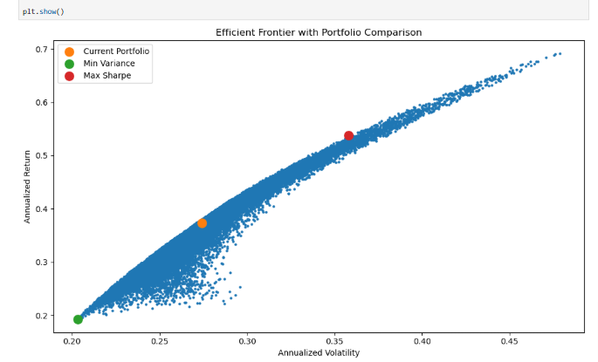
Now Let's compare to Our current Portfolio I can show stakeholders:
whether the current portfolio is efficient
how much improvement optimization provides
what allocation would maximize risk-adjusted return

Slide 23
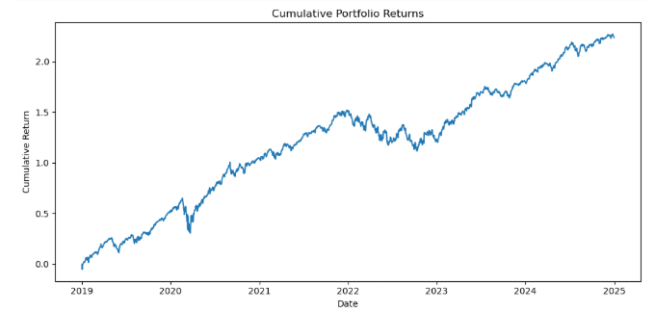
Day 11 Objective - Prepare Dashboard Dataset (for Power BI & Tableau)
Goal: export clean tables your BI tools can load directly.
Steps:
Build portfolio daily returns (time series)
Export asset return dataset
Create risk summary table
Save a quick chart for reference
Now I have clean datasets ready for BI dashboards!

Slide 24

What I Learned Today (Transferable Skills)
1. Data Pipeline Preparation
Built structured datasets from SQL and Python and exported them as clean CSV files for downstream tools. This aligns with fintech roles that require preparing financial and operational datasets for reporting systems, dashboards, and decision-making tools.
2. Financial Risk Metric Reporting
Compiled key portfolio indicators such as return, volatility, Sharpe ratio, and diversification metrics into a summary dataset. This relates to fintech analyst tasks involving monitoring risk KPIs and translating quantitative analysis into metrics that support portfolio or product performance evaluation.
3. Data Visualization Preparation
Generated time-series portfolio performance outputs designed for integration with BI dashboards. This supports fintech responsibilities where analysts translate complex financial data into visual insights that stakeholders and management teams can quickly interpret for strategic decisions.

Slide 25
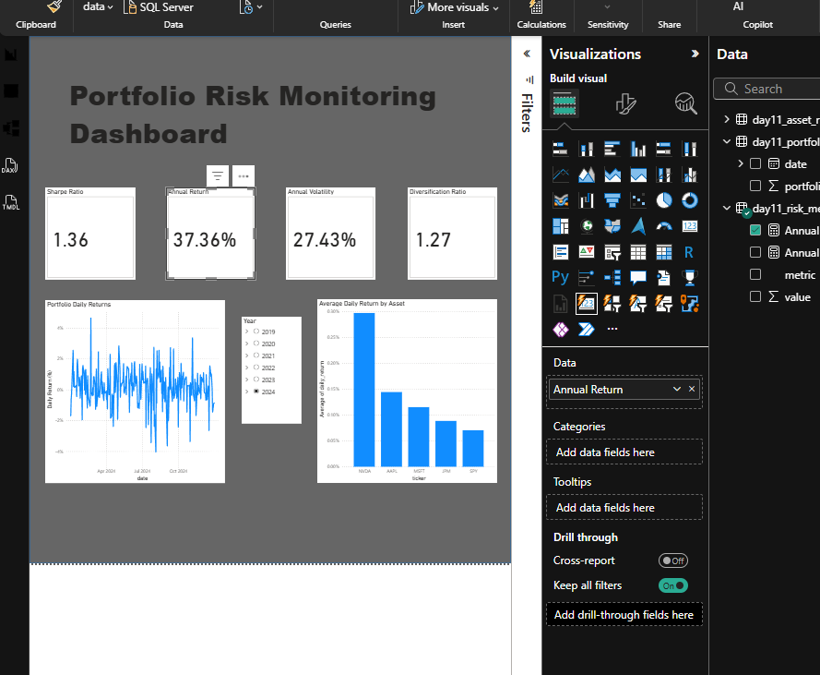
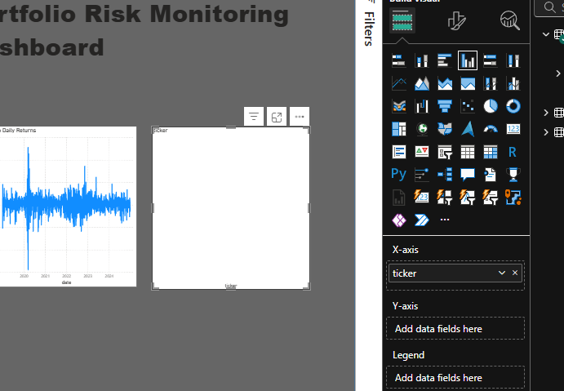
Day 12 Objective
Power BI Risk Dashboard
I will build an interactive risk dashboard in Power BI using the datasets exported from Python so stakeholders can visually monitor portfolio performance, risk metrics, and stress scenarios.
Configuring Dashboard
Deliverable:
Risk Summary
Sharpe Ratio
Annual Return
Annual Volatility
Diversification Ratio
Portfolio Behavior
Daily return time series
Asset Comparison
Average daily return by asset
Interactive Filter
Year slicer

Slide 26
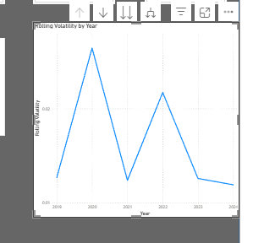
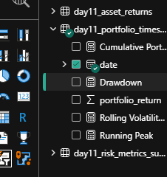
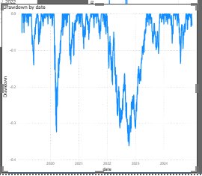
Day 13 Objective
By the end of today I will:
-Add portfolio drawdown visualization to show peak-to-trough losses over time.
-Add rolling volatility chart to illustrate how portfolio risk changes across market regimes.
-Create a risk contribution by asset visualization to show which holdings drive portfolio risk.
-Improve dashboard storytelling so stakeholders can quickly identify risk concentration and downside exposure.
Rolling Volatility Chart
Creating New Measures
On Day 13 I….: expanded the dashboard from performance monitoring to downside risk analytics by adding rolling volatility and portfolio drawdown visualizations. These charts help identify periods of elevated risk, peak-to-trough losses, and recovery dynamics, allowing stakeholders to better understand portfolio stability and downside exposure.
Portfolio Drawdown Curve

Slide 27

The final step is to replicate the dashboard in Tableau.
The goal is not to rebuild everything perfectly, but to show I can work in multiple BI tools:
Power BI → analytics dashboard
Tableau → visual replication
Almost There!!! Just Tap it in!

Slide 28
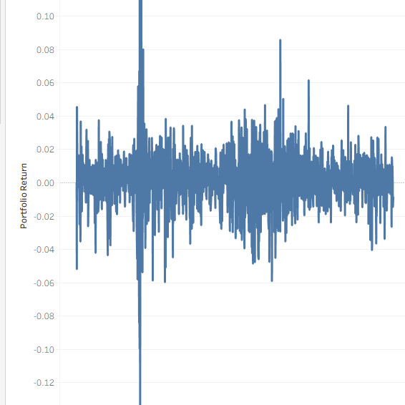
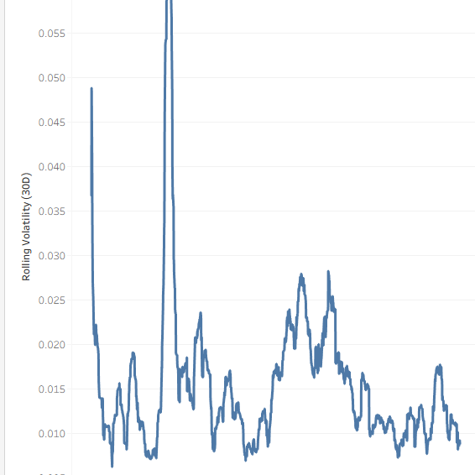
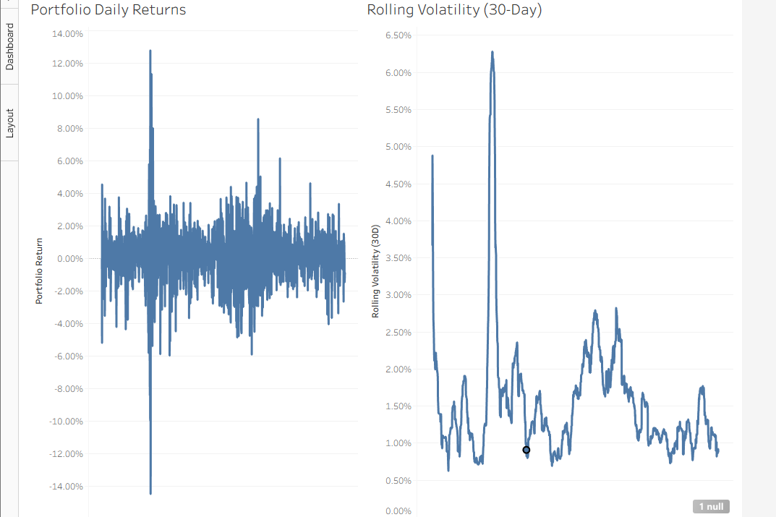
Day 14 Objective
By the end of today I will:
-Replicate the portfolio risk dashboard in Tableau using the same datasets used in Power BI.
-Demonstrate the ability to translate financial analytics across BI platforms.
-Recreate the core visuals: portfolio returns, rolling volatility, drawdown, asset return comparison, and KPI metrics.
-Show proficiency in data visualization tools commonly used in fintech and analytics roles.
Portfolio Returns Chart
Rolling Volatility
On Day 14 I…. recreated the portfolio risk dashboard in Tableau using the same datasets used in Power BI. This demonstrated my ability to translate financial analysis and risk metrics across different BI platforms, ensuring the insights remain consistent while adapting the visualization approach to a different tool.
Tableau Dashboard

Slide 29

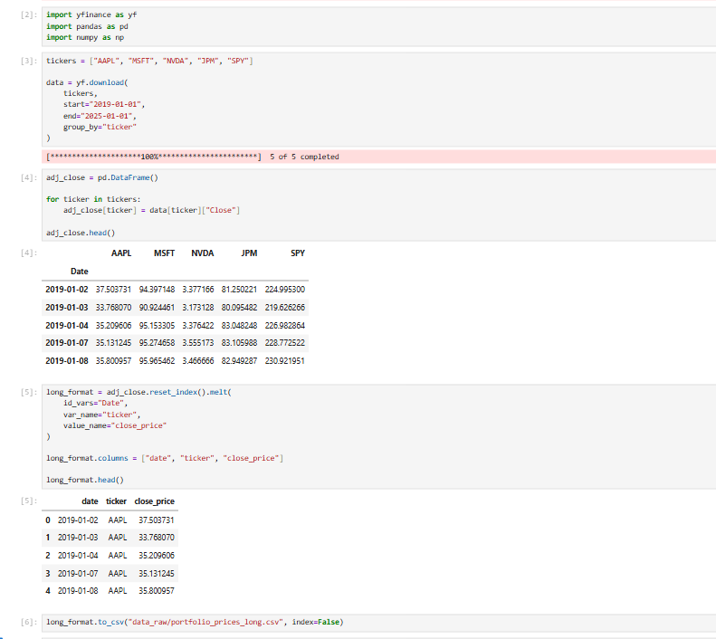
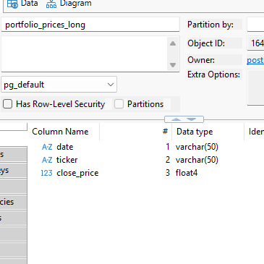
Lessons Learned
Figure 1A. : Because Jupyter notebooks are stateful, variables must be re-executed if the kernel restarts. Stateful means the notebook only remembers things as long as it is running. Since I turned off the computer at night , I have to now rerun the code. Steps: 1. re-import libraries 2. Re-download data 3. Change variable name of dataset from “close” to “Adj close” 4. Convert from wide to long format 5. Save it!
Figure 2A. : Date column stored as text therefore must be date or time series analysis won't be clean
Thanks for Reading!
Figure 1A
Figure 2A

